Slide 1
Everbridge integration with webeoc
Ciprian “Chip” Sufitchi
NCR WebEOC Support
WebEOC User Symposium, Fairfax VA – Oct 17-18, 2019

Slide 2
Facts about Everbridge and how it is used in Fairfax County and NCR

Slide 3
Possible solutions
E-mail ingestion. Everbridge will listen to email messages coming from certain addresses
e.g. NCR EOC Status
WebEOC specialized plugin by Juvare, but none available at this time
In-house application to connect to Everbridge API

Slide 4
Everbridge REST API
REST is an acronym for REpresentation State Transfer
The REST API can be found at https://api.everbridge.net
All transactions can be tested live with Swagger
Swagger: an open-source software framework that helps developers design, build, document, and consume RESTful web services

Slide 5
In order to use Everbridge API…
A special user has to be created (by account manager)
The API user should have admin privileges in order to be able to send messages
The API user should be granted “API” access by Everbridge support personnel
Each API transaction does generally have 3 input parameters:
Username
Password
Organization id

Slide 6
Basic WebEOC board functions
Contacts and groups to be handled by Everbridge web interface
WebEOC calls Everbridge API to get available groups
The board is presenting the groups as checkboxes
WebEOC user selects the groups, the subject, and the message, then presses a Send button
WebEOC calls Everbridge API to send the message to the selected groups

Slide 7
Technical implementation
Internet
Board user interface (view)
Everbridge REST API
/rest/groups/
/rest/notifications/
Ajax
Browser
GET, POST
.NET Form (C#)
Gateway.aspx
HttpWebRequest
getGroups()
sendNotification()
App IIS server (WebEOC)

Slide 8
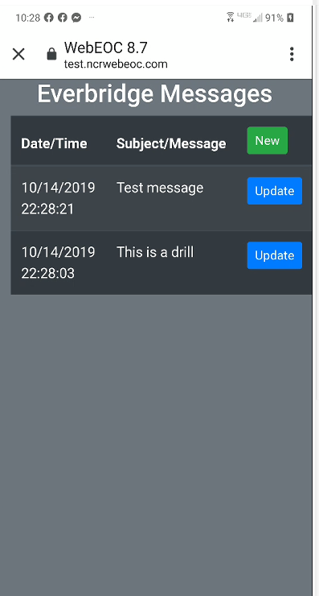
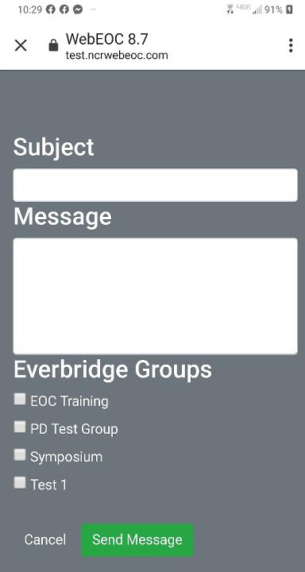
Demo

Slide 9
Thank you!
Questions?

