Slide 1
NCR Emergency Management Technology Summit WebEOC Technical Session
Universities of Shady Grove
Oct 16-17, 2017

Slide 2
WebEOC Technical Session
Programmable events (Fleet Maintenance Tracker board)
MS Outlook Calendar entries created by WebEOC (Calendar board)
Live video/audio streaming into WebEOC
Other

Slide 3
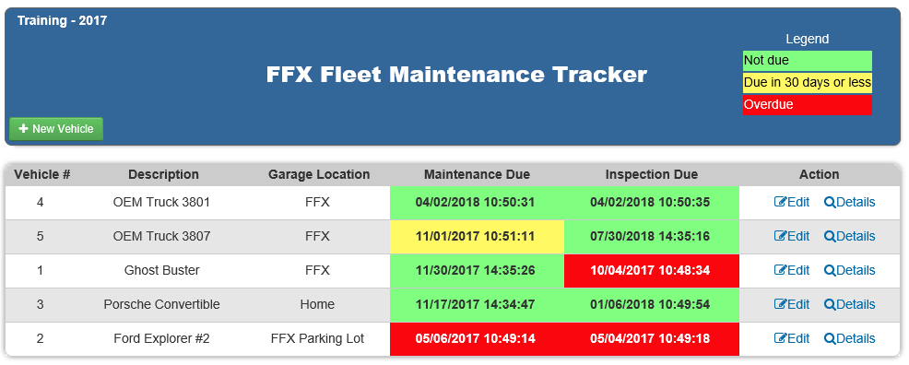
Fleet Maintenance Tracker board

Slide 4
Fleet Maintenance Tracker board
<applicationSettings>
<Fleet_Maintenance_Tracker.Properties.Settings>
<setting name="Fleet_Maintenance_Tracker_WebEOCDev_API" serializeAs="String">
<value>http://10.171.251.47/eoc7/api.asmx</value>
</setting>
</Fleet_Maintenance_Tracker.Properties.Settings>
</applicationSettings>
<appSettings>
<add key="username" value="api" />
<add key="password" value=“*****" />
<add key="position" value=" WebEOC Admin" />
<add key="incident" value="Training - 2017" />
<add key="boardname" value="FFX Fleet Maintenance Tracker" />
<add key="viewname" value="List" />
<add key="inputname" value="Input API" />
<add key="emailfrom" value="support@ncrwebeoc.com" />
<add key="emailto" value="ciprian.sufitchi@fairfaxcounty.gov" />
<add key="smtp" value="10.171.32.53" />
</appSettings>

Slide 5
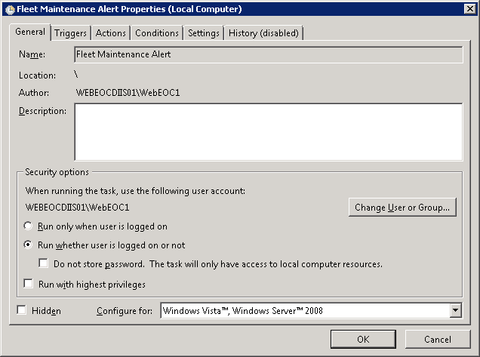
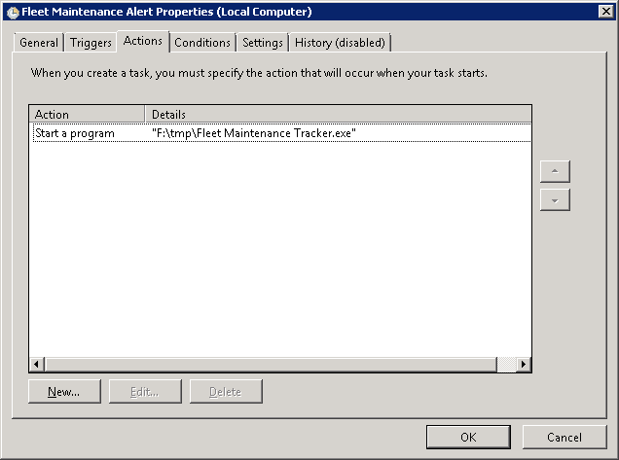
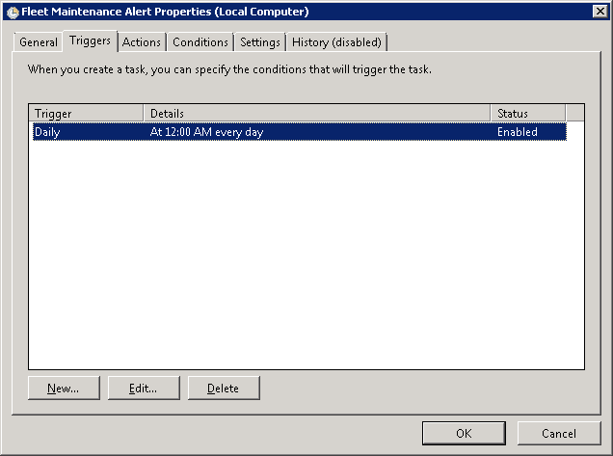
Fleet Maintenance Tracker board

Slide 6
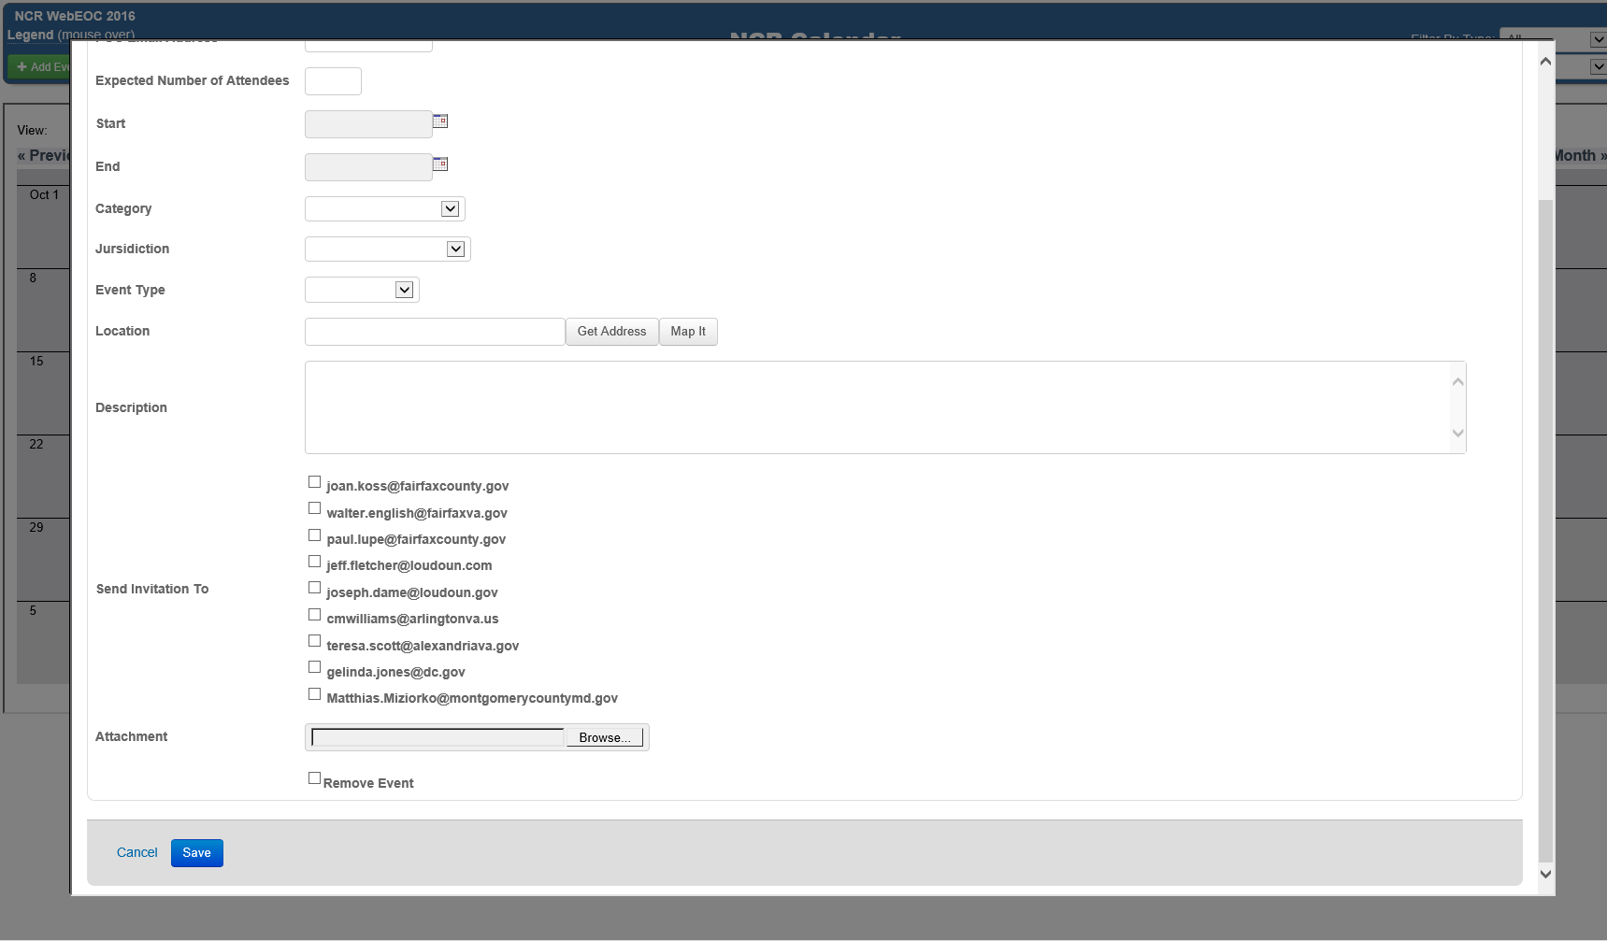
Calendar board

Slide 7
Calendar board
str.AppendLine(String.Format("CREATED:{0:yyyyMMddTHHmmss}", DateTime.Now));
str.AppendLine(String.Format("DTSTAMP:{0:yyyyMMddTHHmmss}", DateTime.Now));
//str.AppendLine(String.Format("DTSTART;TZID=\"America/New_York\":{0:yyyyMMddTHHmmss}", objApptEmailStartDate));
//str.AppendLine(String.Format("DTEND;TZID=\"America/New_York\":{0:yyyyMMddTHHmmss}", objApptEmailEndDate));
str.AppendLine(string.Format("DTSTART:{0:yyyyMMddTHHmmssZ}", objApptEmailStartDate.ToUniversalTime().ToString("yyyyMMdd\\THHmmss\\Z")));
str.AppendLine(string.Format("DTEND:{0:yyyyMMddTHHmmssZ}", objApptEmailEndDate.ToUniversalTime().ToString("yyyyMMdd\\THHmmss\\Z")));
str.AppendLine("LOCATION:" + objApptEmailLocation);
str.AppendLine(String.Format("UID:{0}", Guid.NewGuid()));
str.AppendLine(string.Format("DESCRIPTION:{0}", objApptEmailBody));
str.AppendLine(string.Format("X-ALT-DESC;FMTTYPE=text/html:{0}", objApptEmailBody));
str.AppendLine(string.Format("SUMMARY:{0}", objApptEmailSubject));
str.AppendLine(string.Format("ORGANIZER:MAILTO:{0}", objApptEmailOrganizer));
str.AppendLine(string.Format("ATTENDEE;CN=\"{0}\";RSVP=TRUE:mailto:{1}", msg.To[0].DisplayName, msg.To[0].Address));
str.AppendLine("BEGIN:VALARM");
str.AppendLine("TRIGGER:-PT15M");
str.AppendLine("ACTION:DISPLAY");
str.AppendLine("DESCRIPTION:Reminder");
str.AppendLine("END:VALARM");
str.AppendLine("END:VEVENT");
str.AppendLine("END:VCALENDAR");
System.Net.Mime.ContentType ct = new System.Net.Mime.ContentType("text/calendar");
ct.Parameters.Add("method", "REQUEST");
AlternateView avCal = AlternateView.CreateAlternateViewFromString(str.ToString(), ct);
msg.AlternateViews.Add(avCal);

Slide 8
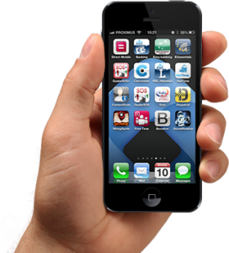
Live audio/video streaming
Board
Board
Board
WebEOC
Smartphone or iPhone
Standard RTMP streaming
HTML 5 Player
<video/>
RTMP
Port 1935
HLS
Port 8080
Media server
Linux Centos 6
Nginx + RTMP Plugin

